Slide 1
Chapter 12
How to work with tables

Slide 2
Objectives
Applied
Use HTML to create tables with merged cells, captions, headers, and footers.
Use CSS and the CSS structural pseudo-classes to format the tables that you create.
Use the HTML figure and figcaption elements to treat a table as a figure.
Use HTML attributes to provide accessibility for tables.
Use media queries to make tables responsive.

Slide 3
Objectives (continued)
Knowledge
Describe these components of a table: rows, columns, cells, header cells, data cells, table header, table footer, and table body.
Describe the proper use of tables.
Describe the use of the table attributes for accessibility.
Describe the use of media queries for making tables responsive.

Slide 4
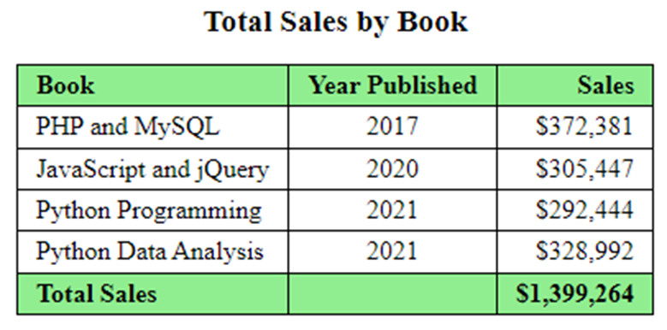
A simple table with basic formatting

Slide 5
The HTML for a table before it’s formatted
<table>
<tr>
<th class="left">Book</th>
<th>Year Published</th>
<th>Sales</th>
</tr>
<tr>
<td class="left">PHP and MySQL</td>
<td>2017</td>
<td>$372,381</td>
</tr>
<tr>
.
.
</tr>
<tr>
<th class="left">Total Sales</th>
<td></td>
<td>$1,399,264</td>
</tr>
</table>

Slide 6
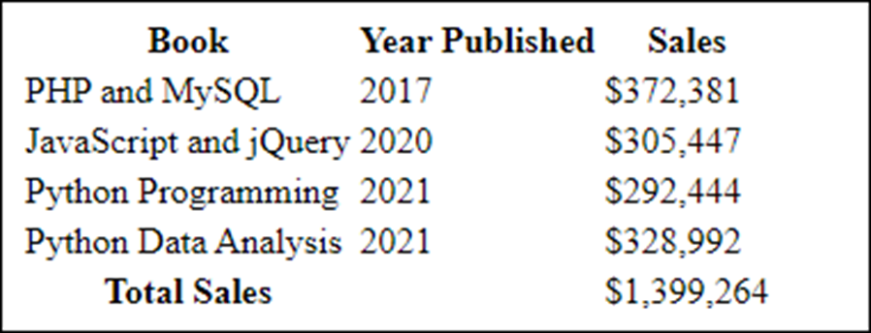
The table in a web browser with no CSS formatting

Slide 7
A table with a header, body, and footer
<thead>
<tr>
<th class="left">Book</th>
<th>Year published</th>
<th>Total sales</th>
</tr>
</thead>
<tbody>
<tr>
<td class="left">PHP and MySQL</td>
<td>2017</td>
<td>$372,381</td>
</tr>
...
</tbody>
<tfoot>
<tr>
<th class="left">Total Sales</th>
<td></td><td>$1,399,264</td>
</tr>
</tfoot>

Slide 8
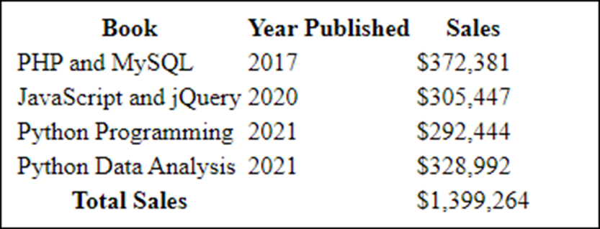
The table with a header and footer

Slide 9
Common properties for formatting table, tr, th, and td elements
border-collapse
border-spacing
padding
text-align
vertical-align

Slide 10
The CSS for the table
table {
border: 1px solid black;
border-collapse: collapse; }
th, td {
border: 1px solid black;
padding: .2em .7em;
text-align: right; }
th.left, td.left { text-align: left; }
thead, tfoot { background-color: lightgreen; }
tfoot { font-weight: bold; }

Slide 11
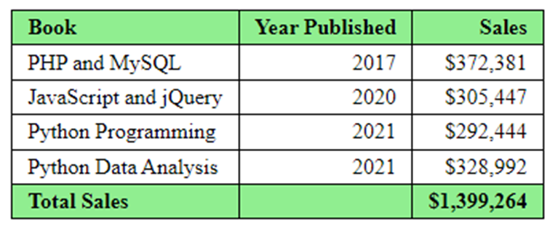
The formatted table

Slide 12
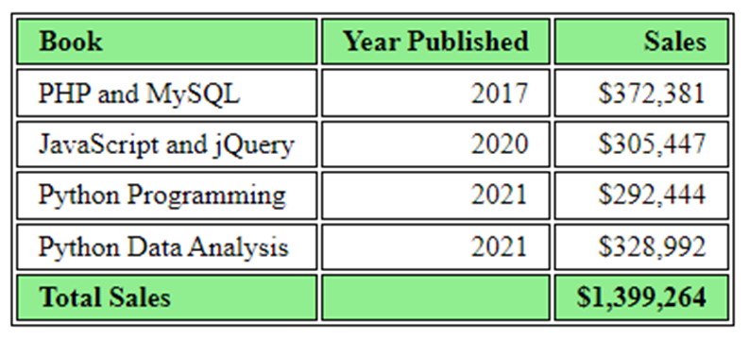
The table without collapsed borders

Slide 13
The CSS structural pseudo-class selectors
:nth-child(n)
:nth-last-child(n)
:nth-of-type(n)
:nth-last-of-type(n)
Typical n values
odd
even
n
3n
2n+1
3n+1

Slide 14
CSS for table formatting without using classes
th:first-child, td:first-child {
text-align: left; }
th:nth-child(2), td:nth-child(2) {
text-align: center; }
tbody tr:nth-child(even) {
background-color: lightyellow; }

Slide 15
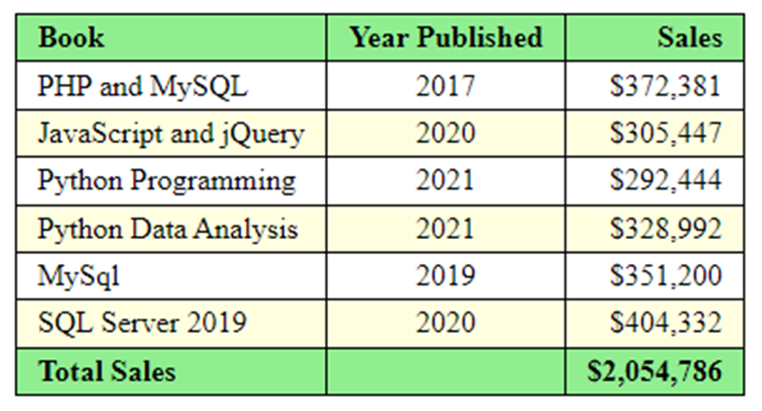
The table formatted with structural pseudo-classes

Slide 16
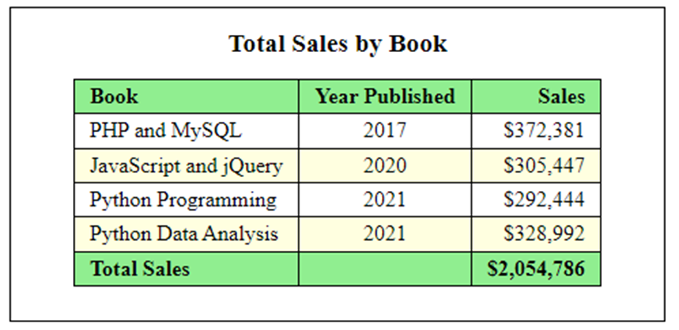
A table within a figure

Slide 17
The HTML for the figure and figcaption elements
<figure>
<figcaption>Total Sales by Book</figcaption>
<table>
.
.
</table>
</figure>

Slide 18
The CSS for the figure and figcaption elements
figure, figcaption {
margin: 0;
padding: 0; }
figure {
border: 1px solid black;
width: 450px;
padding: 15px; }
figcaption {
display: block;
font-weight: bold;
text-align: center;
font-size: 120%;
padding-bottom: .25em; }
table {
border-collapse: collapse;
border: 1px solid black;
margin: 10px auto; }

Slide 19
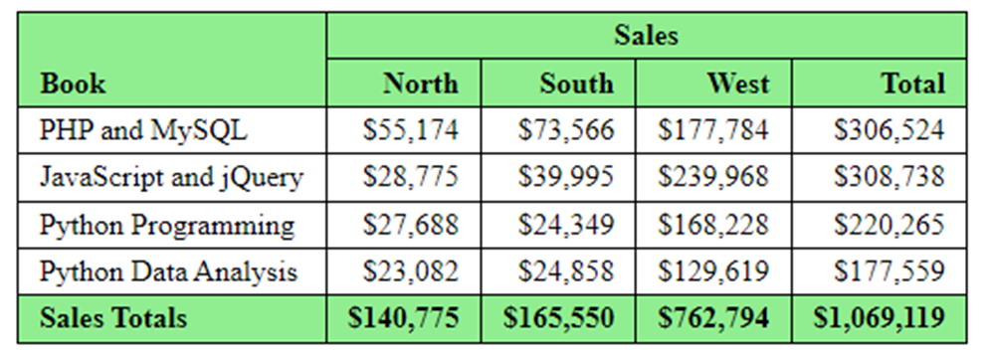
A table with merged cells

Slide 20
The critical HTML for the table
<table>
<thead>
<tr>
<th rowspan="2">Book</th>
<th colspan="4">Sales</th>
</tr>
<tr>
<th>North</th>
<th>South</th>
<th>West</th>
<th>Total</th>
</tr>
</thead>
...
...
</table>

Slide 21
The CSS for the merged cells
th:first-child {
vertical-align: bottom;
}
th:nth-child(2) {
text-align: center;
}
tr:nth-child(2) th {
text-align: right;
}

Slide 22
A table that provides for accessibility
<caption>Total sales from 2012 to 2017</caption>
<thead>
<tr>
<th id="hdr_book" scope="col">Book</th>
<th id="hdr_year" scope="col">Year Published</th>
<th id="hdr_sales" scope="col">Sales</th>
</tr>
</thead>
<tbody>
<tr>
<td headers="hdr_book">PHP and MySQL</td>
<td headers="hdr_year">2017</td>
<td headers="hdr_sales">$372,381</td></tr>
...
</tbody>
<tfoot>
<tr>
<th id="hdr_total" scope="row">Total Sales</th>
<td></td>
<td headers="hdr_sales hdr_total">...</td></tr>
</tfoot>

Slide 23
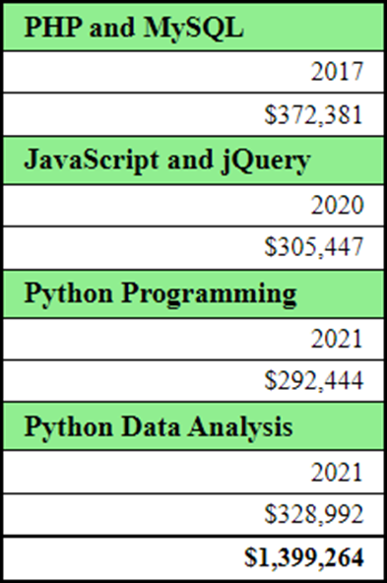
A table after it’s reformatted for smaller screens

Slide 24
The media query for the table
@media only screen and (max-width: 479px) {
th, td { display: block; }
thead { display: none; }
tr td:first-child {
font-weight: bold;
font-size: 110%;
background-color: lightgreen;
}
tbody td {
border-bottom-style: none;
}
tfoot {
background-color: white;
border: none;
border-top: 1px solid black;
}
tfoot th, tfoot td:nth-of-type(1) {
display: none;
}
}

Slide 25
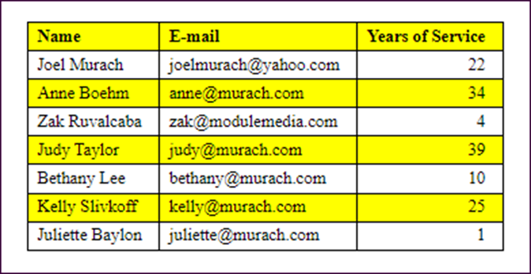
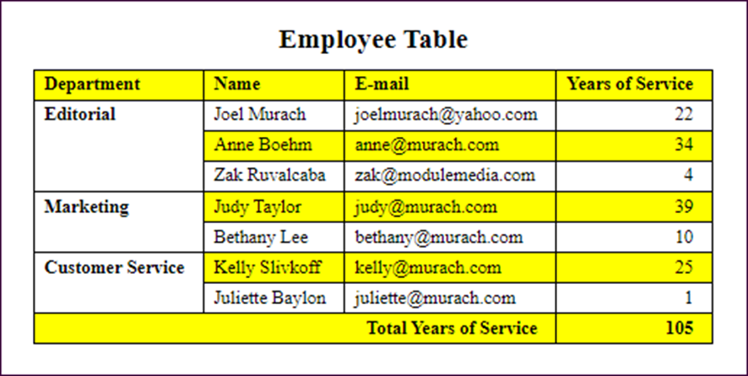
Short 12-1 Enhance a table

